Slide 1
K Means Algo

Slide 2
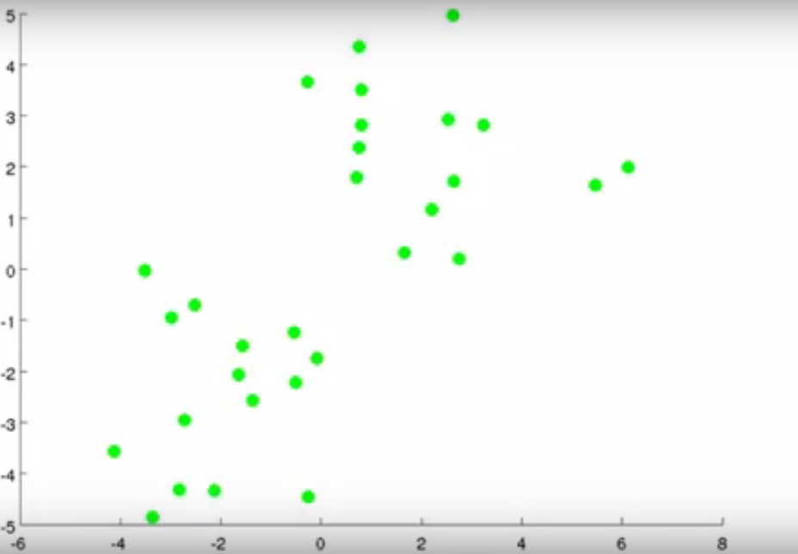
Inputs
a. Unlabeled dataset
Objective:
Group the data in 2 clusters.

Slide 3
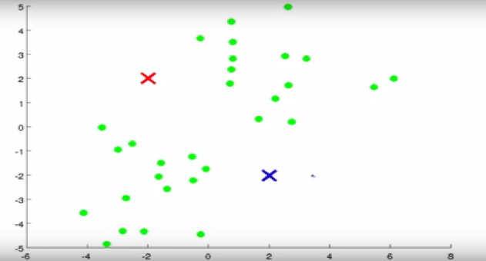
Step 1: Randomly select Centroids. We are taking 2 centroids as grouping of data in 2 clusters.

Slide 4
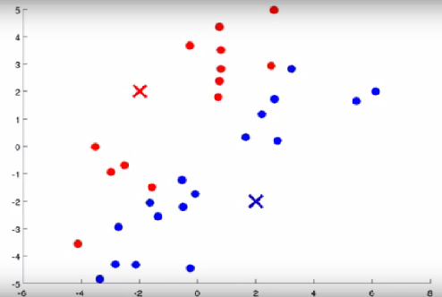
Step2: K Means does two things:
Cluster Assignment(As done in Step1).
Move Centroids.

Slide 5
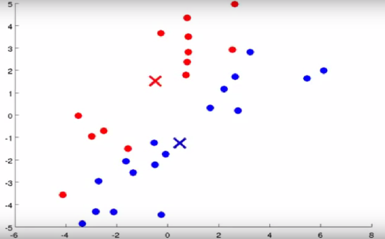
Step 3: Execute Inner loop and in this loop, go to each and every point which seems to belong to cluster. Calculate mean and move centroids to new means.(see new position of Centroids)

Slide 6
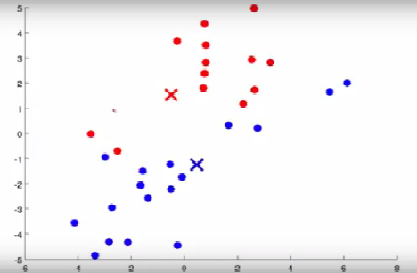
Step 4 : Repeat step 2, and now points which are closer to either RED or BLUE centroid, we will be marking them as per respective color.

Slide 7
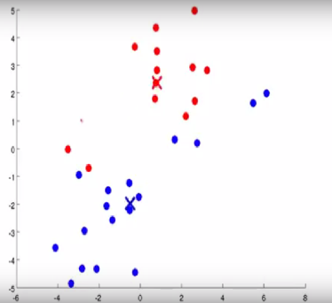
Step 5 : New data points, again move Centroids(Avg of all blue points & Avg of all Red points).

Slide 8
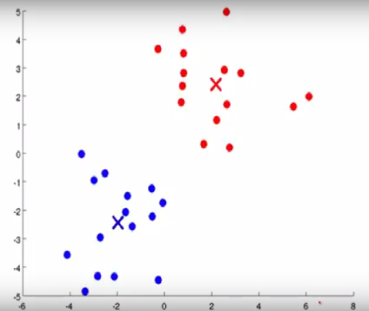
Step 6 : One more iteration and now final centroids will look like.
Step 7: Keep on running iteration, and there will no new centroid movement which means that our algo has finally converged and these are my final values.

Slide 9
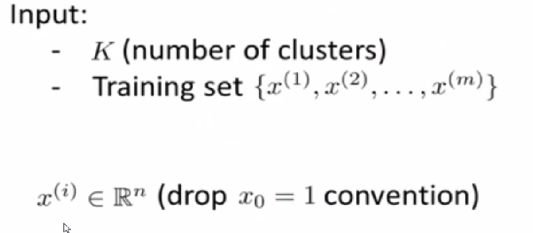
K MEANS ALGO
K = Number of Clusters you want to find in Data.
Training Set = Unlabeled training data.(Unsupervised learning)
R^n = n dimensional vector

Slide 10
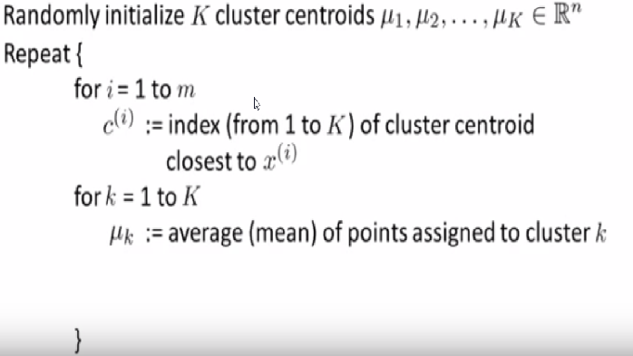
K Means Algo
,u = location of Red and Blue Cross
1st Loop = Cluster Assignment Step
C(i) = min (|| x^I -,uK ||) ^2 = minimum Sum of Squared
2nd Loop = Move Centroid Step.(For each centroid, calculate the avg of points assigned to that cluster)

